Slide 1
Global Marketing
Management
A European Perspective
GLOBAL MARKETING
COMMUNICATION
Warren J. Keegan
Bodo B. Schlegelmilch

Slide 2
Global Advertising and Branding I
The global marketer
  has to pay attention to the interaction of the elements of the communication mix
  has to ascertain that the right message is communicated and received by prospective consumers (i.e. cultural diversity, media limitations, legal problems)
Needs to take care of cultural diversity, media limitations, legal differences, etc.

Slide 3
Global Advertising and Branding II
Global campaigns
  help to build long-term product identities
  offer significant savings in production costs
Global advertising
  offers companies economies of scale in advertising
  improves access to distribution channels

Slide 4
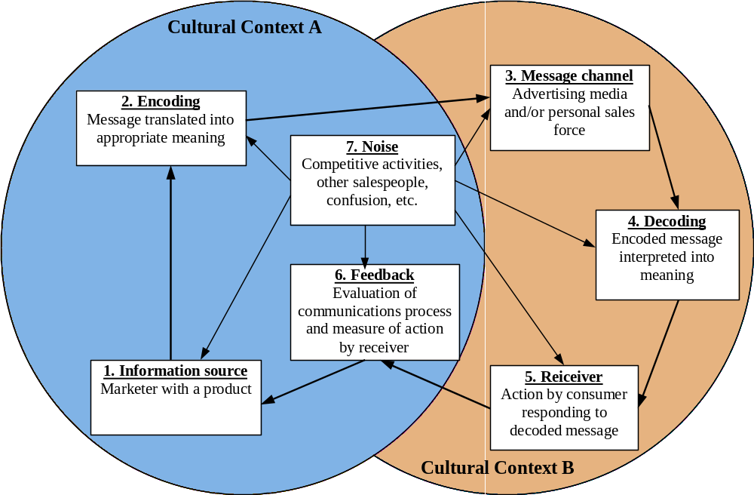
Global Advertising and Branding III
Source: Cateora, P.C. International Marketing. Homewood: Irwin, 1993, p. 522.

Slide 5
Advertising
May be defined as any sponsored, paid message placed in a mass medium
Global advertising refers to the use of the same advertising appeals, messages, art, copy, photographs, stories, and video segments in multiple-country markets

Slide 6
The Extension versus Adaptation Debate I
Four major difficulties
  the message may not get through to the intended recipient
  the message may reach the target audience but may not be understood or may even be misunderstood
  the message may reach the target audience and may be understood but still may not induce the recipient to take the action desired by the sender
  the effectiveness of the message can be impaired by noise

Slide 7
The Extension versus Adaptation Debate II
Key question for global marketers
  Does the specific advertising message and media strategy need be changed because of environmental requirements?
Two positions
  ”one world, one voice” approach
  localised approach

Slide 8
Impact of Information Technology on Advertising I
Direct marketing is growing rapidly:
  increased use of computer databases, credit cards, and toll-free numbers, as well as changing lifestyles
  system of marketing that integrates ordinarily separate marketing mix elements to sell directly to both consumers and other businesses, bypassing retail stores and personal sales calls

Slide 9
Impact of Information Technology on Advertising II
Possible to target advertising messages in magazines and newspapers more selectively
  less cost intensive and easier printing techniques
”Electronic newspaper" allows consumers to create their own personal newspaper
  many articles from contemporary newspapers and magazines are already available in the Internet

Slide 10
Selecting an Advertising Agency I
Options:
  create ads in house
  use an outside agency
  combine both strategies
One or more outside agencies
  can serve product accounts on a multicountry or global basis

Slide 11
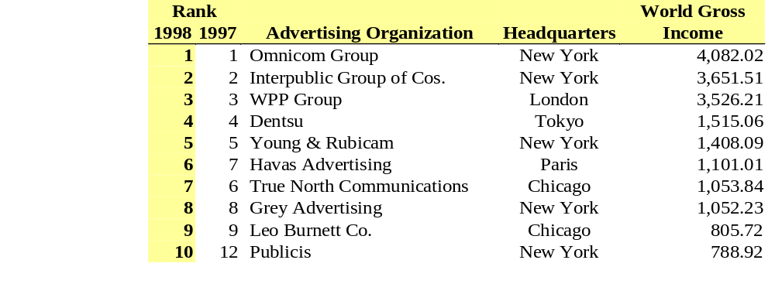
Selecting an Advertising Agency II
World’s Top Advertising Organisations (€ Millions)

Slide 12
Selecting an Advertising Agency III
In selecting an advertising agency, the following issues should be considered
  Company organisation
  National responsiveness
  Area coverage
  Buyer perception

Slide 13
Advertising Appeals and Product Characteristics
The most effective appeal may vary
  products might be at different stages in their life cycle in various national markets
  basic cultural, social, and economic differences
Global marketers should identify opportunities where:
  economies of scale exist
  barriers to standardisation such as cultural differences are not significant
  products satisfy similar functional and emotional needs across different cultures

Slide 14
Creating Advertising
Art Direction
Copy
Cultural considerations
  values and motives
  advertising form
  execution of the advertising
Global media considerations
  media decisions
  media vehicles and expenditures

Slide 15
Public Relations I
A non-paid form of communication
PR’s job is to make sure that
  the company responds promptly to unflattering media reports or controversies
  gets its side of the story told
The basic tools of PR include
  news releases, newsletters, press conferences, tours of plants and other company facilities, articles in trade or professional journals, company publications and brochures, TV and radio talk show appearances by company personnel, special events, and the Internet

Slide 16
Public Relations II
Sponsoring
  the target group is familiarised with a product, brand or company name
  sponsors aim to establish and consolidate the impression customers have of the enterprise and of brands
  sponsoring intends to transfer a distinct image and to build awareness

Slide 17
Sales Promotion
Refers to any consumer or trade program of limited duration that adds tangible value to a product or brand
The purpose of a sales promotion
  to stimulate customers to sample a product
  to increase consumer demand
  to increase product availability in distribution channels

Slide 18
Personal Selling
Two-way: personal communication between a company representative and a potential customer
Additional challenges
  buyer and seller come from different national or cultural backgrounds
Selling process is divided into several stages
  prospecting, pre-approach, approaching, presenting, problem solving, handling objections, closing the sale, and following up

